Slide 1


Slide 2
Internet
Presented by:
BADAR RASHEED BUTT
211370113
PRESENTED TO:
MAM SHAZMA NOOR

Slide 3

What is internet
The Internet is a vast network that connects computers all over the world. Through the Internet, people can share information and communicate from anywhere with an Internet connection.
It is a very large wide area network (WAN) connecting computers It makes it possible for millions of users to connect to one another via telephone lines, cable lines, and satellites
and networks around the world.

Slide 4
How did the internet developed?
Internet was born in late 1960’s
The internet has its root in the APRANET system of the ADVANCED RESEARCH PROJECT AGENCY of U.S. Department of Defense which linked together mainframe computers to form a communication networks.
APRANET is known as the forefather of internet.

Slide 5
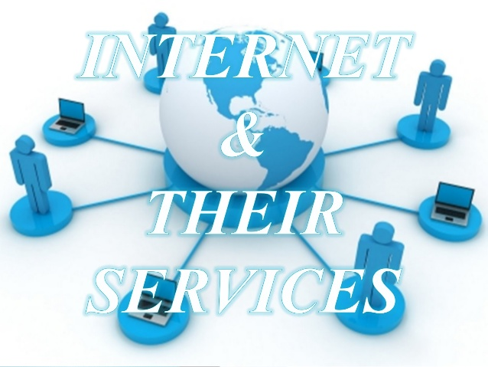
Basic services of internet
Electronic mail
FTP
Talnet
Usenet news
The World Wide Web

Slide 6
Electronic Mail
It is also known as e-mail in short.
It enables to send and receive a mail.(message)
It is faster than paper mail.
Images , audio , video can be sent along with text.

Slide 7
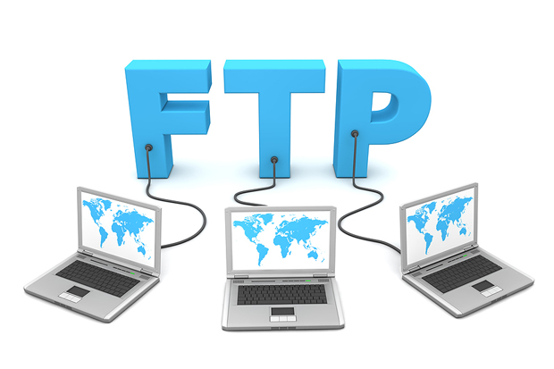
File Transfer Protocol (FTP)
It enables users to move a file from one computer to another computer.
A file may contain:
Text document
Image
Artwork
Movie
Sound
Software

Slide 8
Talnet
Talnet service enables users to login to another computer on internet from their local computer for using:
Computing power of remote computer
Software on remote computer
Database of remote computer
This action is called remote login

Slide 9
Usenet News
Usenet news service enables a group of internet users to exchange their views , ideas, information on some common topic of internet.
A news group is like a large notice board accessible to all members belonging to the group.
Two types of news groups.
Moderated
Non-moderated

Slide 10
The World Wide Web
It is a most popular method of accessing internet.
It uses a concept called hypertext
Hypertext documents on internet are known as web pages.
Web pages are created by using a special language called Hyper Text Markup Language

Slide 11
Uses of internet
Online communication
Exchange of views on topics of common interest
Posting of information on general interest
Product promotion
Feedback about product
Customer support service

Slide 12

Online Communication
Online communication refers to the ways in which individuals as well as computers can communicate with each other over a computer network , such as the internet . These ways include chat rooms ,e-mails.

Slide 13
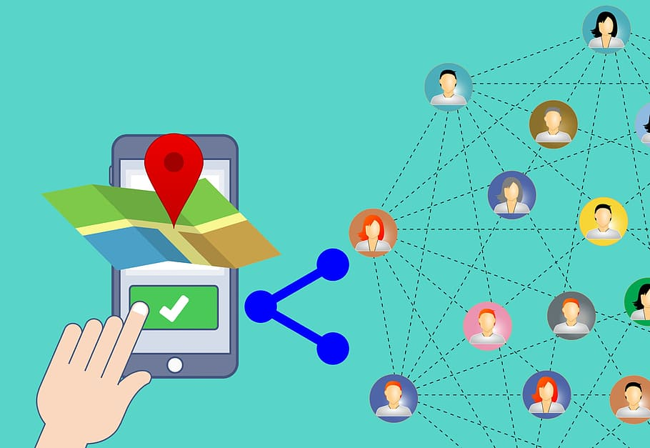
Software sharing
Software sharing is the practice of sharing or offering access to digital information or resources, including documents, multimedia
(audio/video), graphics, computer programs, images and e-books.
It is the private and public distribution of data or resources in a network with different levels of sharing priviliges.

Slide 14
Protocol
A set of guidelines and rules.
Communications protocol is a formal description of message formats and the rules for exchanging those messages.
Format that agreed to transfer data between two devices.
Hypertext Transfer Protocol(HTTP)
Internet Protocol(IP)
File transfer Protocol(FTP)
Simple Mail Transfer Protocol(SMTP)
Networks News File Transfer Protocol(NNTP)
Transmission Control Protocol (TCP);Normally use together with IP.

Slide 15
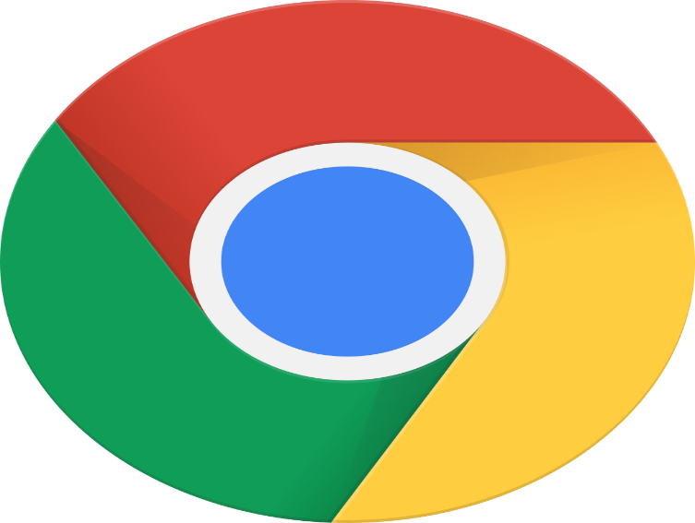
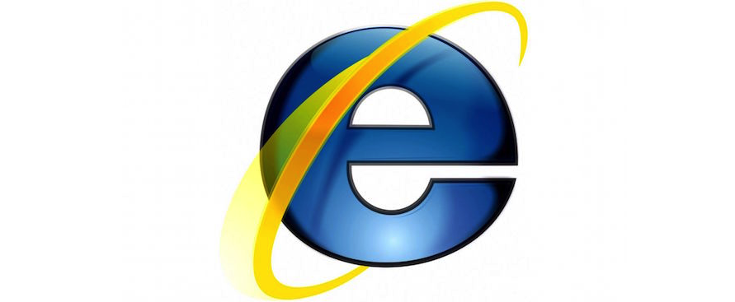

Different types of web browsers:
This Photo by Unknown Author is licensed under CC BY-SA

Slide 16
Advantages of Internet:
Communication
Research
Education
Financial transactions
For updates

Slide 17
Disadvantages of internet:
Theft of personal information
Spamming
Malware threats
Social isolation, obesity and depression.

Slide 18

Thankyou for your concentration

